Slide 1

Data structure
Ali AbuAboud

Slide 2
Introduction
What is the problem?
What are the variables ?
What is the solution?

Slide 3
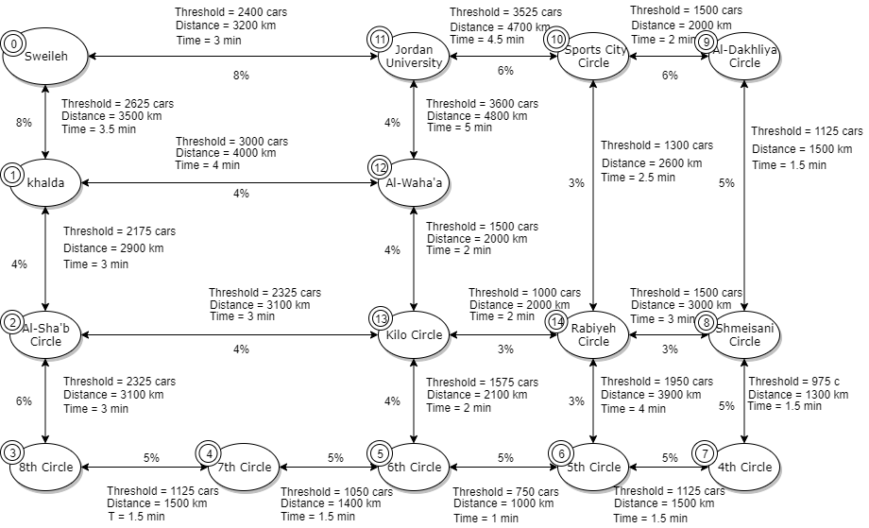
The Graph
Nodes
Threshold
Distance
Percentage (Assumed)

Slide 4
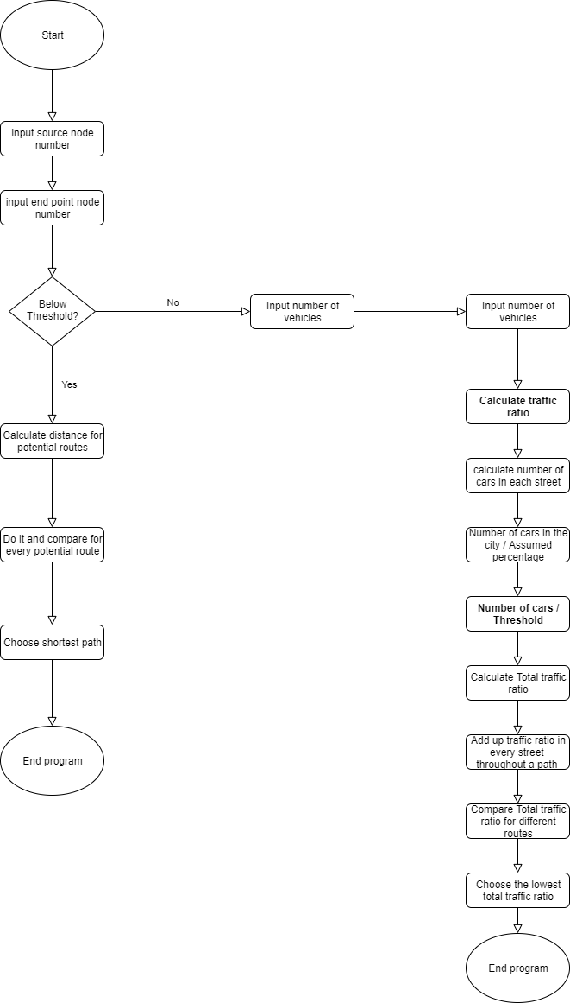
Flowchart
Three scenarios with two solution
Below Threshold: Shortest path
Above and in between: Traffic ratio solution

Slide 5
Why did we use classes
Advantages
Features

Slide 6
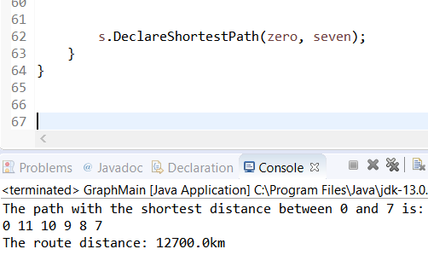
Code outputs
We decide the start point and the end point
The program prints the path
Prints the distance

Slide 7

Complexity
Time complexity
Space complexity

Slide 8
Advantages of data structure
Reusable
Abstraction
Memory efficiency

Slide 9
Questions?
Thank You
Done by Ali AbuAbboud
Date: 23/ 1/ 2020

